Slide 1
COMPUTER Education PROGRAM for AFSCME EMPLOYEES
Ms. Enid Weisman Chief Human Capital Officer
Office of Human Capital Management

Slide 2
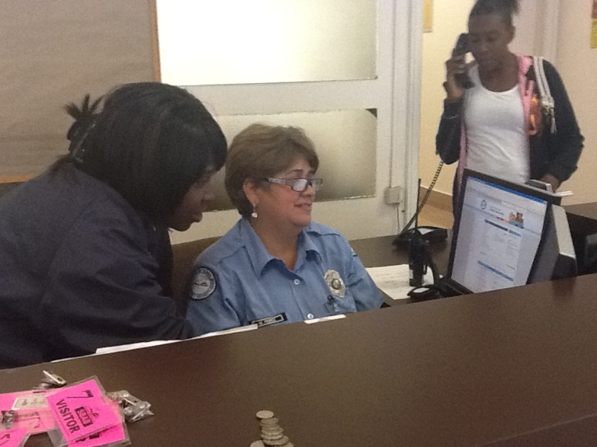
WHY DO WE NEED THIS?
Life skills training in computer proficiency is necessary to improve the lives of M-DCPS employees with limited technological access so they can:
Increase earning power
Advance career opportunities
Improve self-image

Slide 3
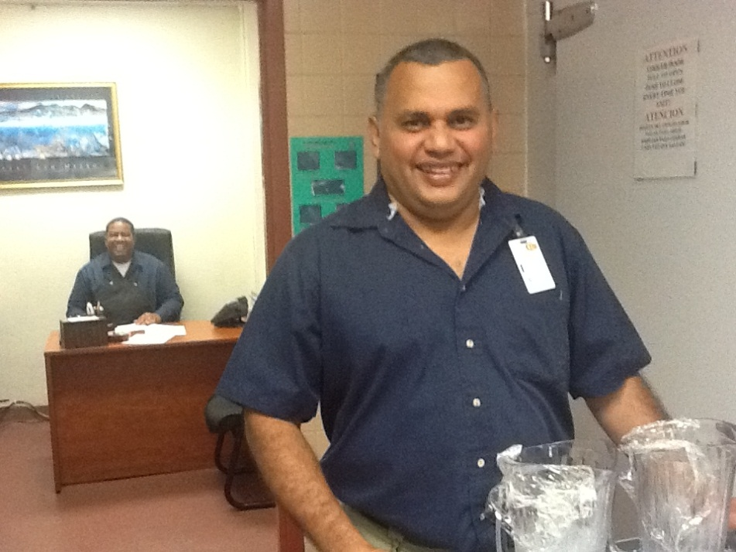
HOW CAN WE ACCOMPLISH THIS?
1) Train-the-Trainer for on-site training at each work location
2) Videos are available in English, Creole, and Spanish covering the following topics:
Basic Needs (Why we need the Computer)
Turning the Computer On
Basic Functions (Mouse, Keyboard, Desktop)
Using the Internet
Employee Portal
Registering for Professional Development
3)Ensure that Trainers and AFSCME employees have on going access to the resources website: http://computereducation.dadeschools.net

Slide 4
Where can you find us?
Located on the Office of Human Capital Management website, this site will be used by the Trainer to facilitate computer training for AFSCME employees. Thereafter, the site can be accessed for follow-up and/or additional trainings.
HTTP://CUSTODIANS.DADESCHOOLS.NET/

Slide 5
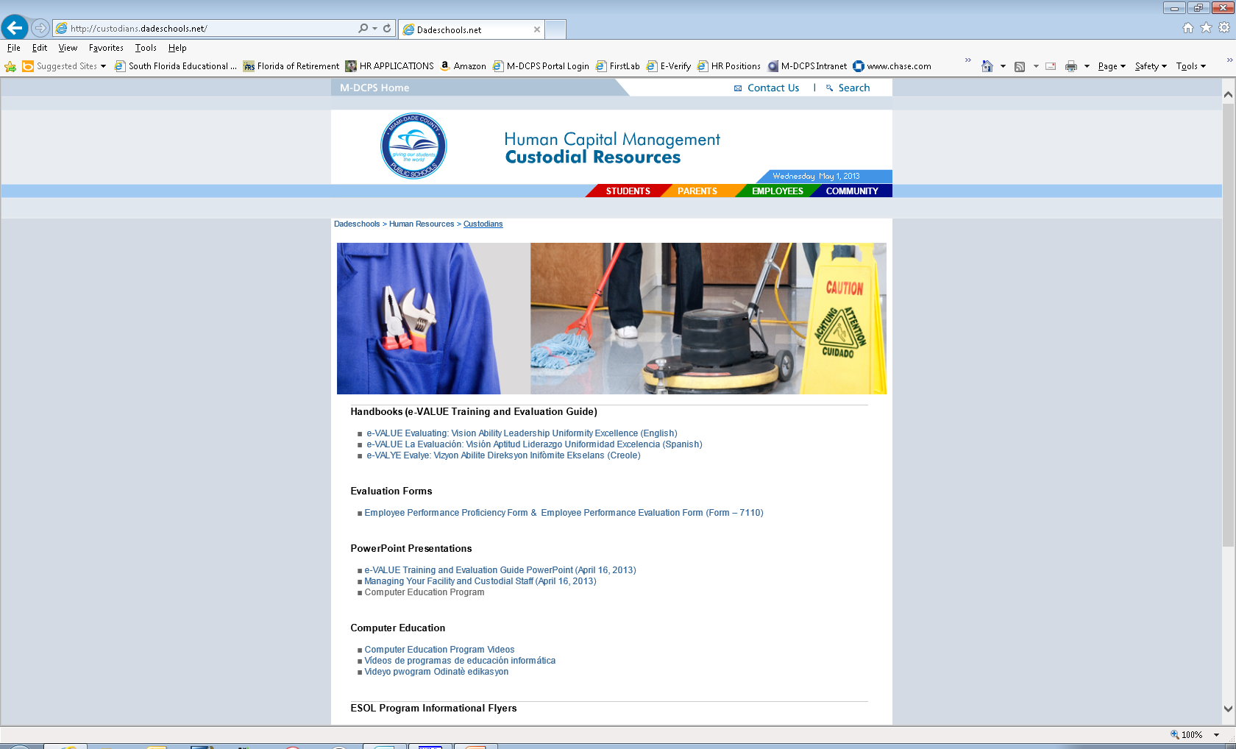
CustodiaL resources website

Slide 6
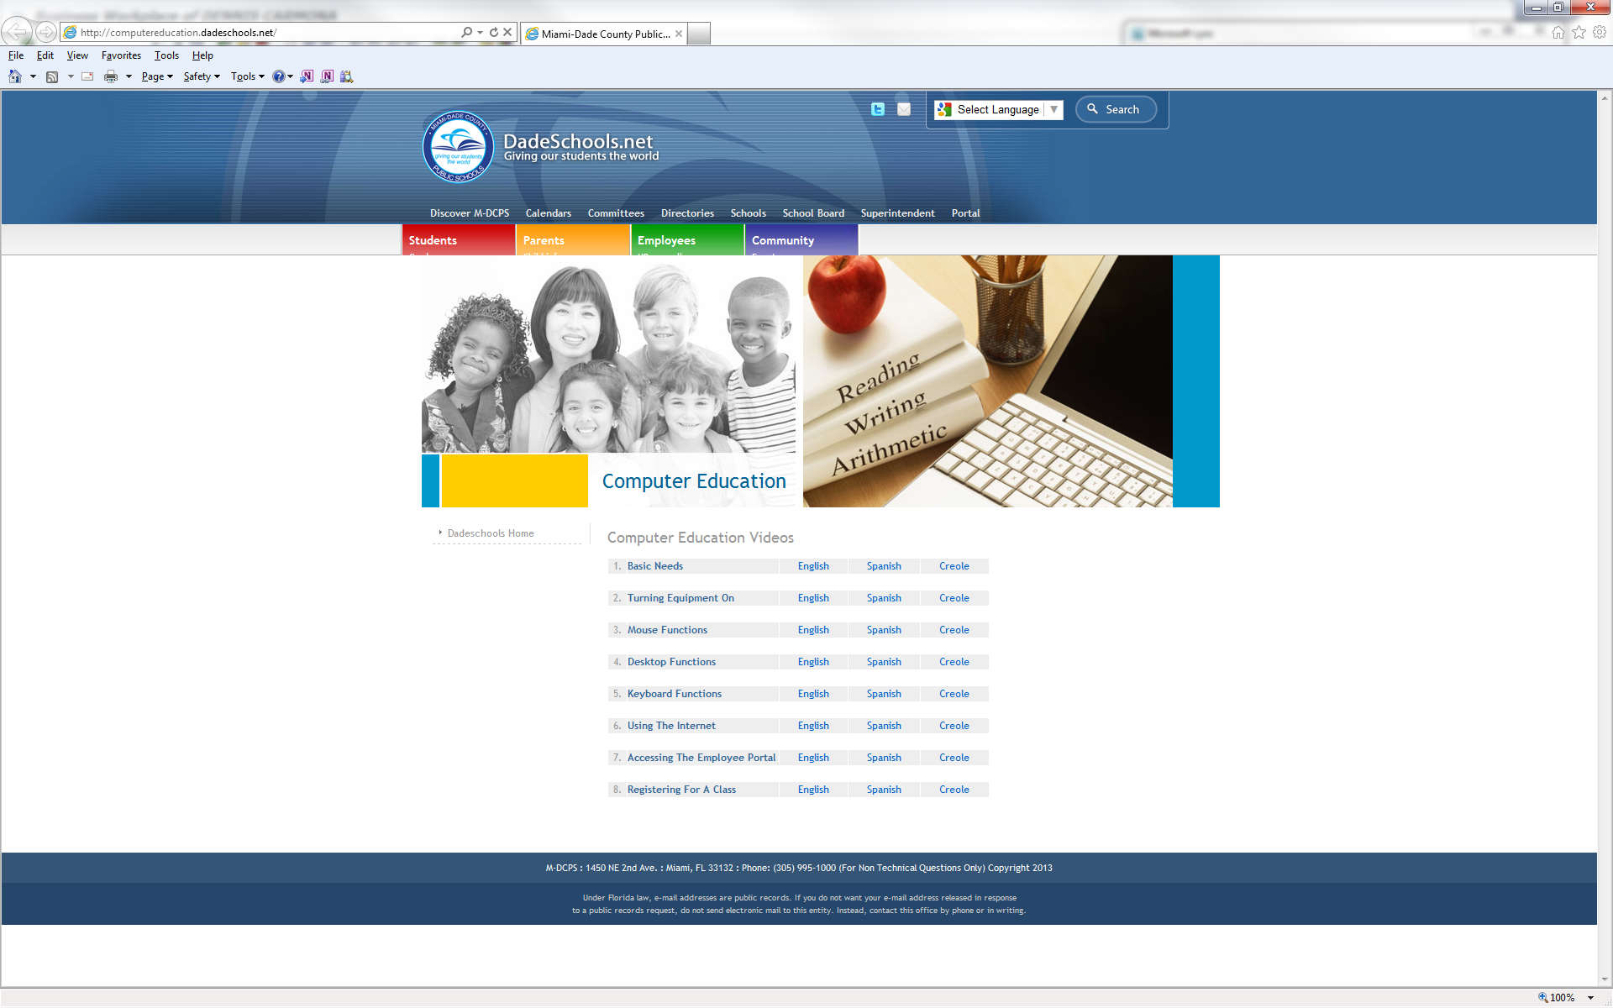
COMPUTER education VIDEOS

Slide 7
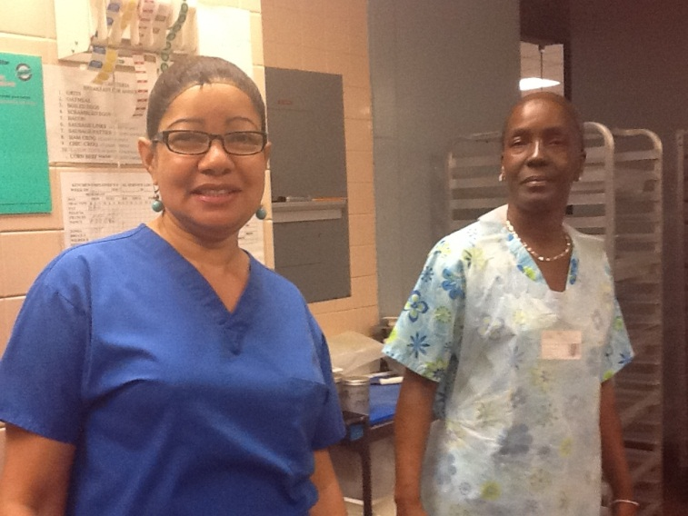
WHERE DO WE TRAIN OUR STAFF?
Training will take place at the individual work locations. You will need:
A dedicated room
A Smartboard/Projection Screen
Computer stations for hands-on training

Slide 8
WHEN DO WE TRAIN?
As soon as possible before the end of the school year and as often thereafter as necessary or when new employees are hired at the work location.
Notes:
Understand that this will not be a quick process. It won’t be a smooth process. You may find that you train the same person multiple times. But the process is necessary, nonetheless.

Slide 9
FOR MORE INFORMATION
Please contact:
Dr. Sherry Krubitch, Administrative Director Office of Human Capital Management/Employee Services 305-995-4735
skrubitch@dadeschools.net
Ms. Andrea M. Williams, Director
Office of Human Capital Management/Personnel Support Programs
305-995-1416
amwilliams@dadeschools.net
Ms. Jacqueline L. Brinson, Manager III
Office of Plant Operations
305-835-1050
jlbrinson@dadeschools.net

